Slide 1
DATA COMMUNICATION Madan Raj Upreti Nepal Engineering college Changunaryan- Bhaktapur

Slide 2
Text Book
William Stallings, Data and Computer Communications, fifth edition
References
U.D. Black, Data Communications and Distributed Networks Behrouz Forouzan, Introduction to Data Communications and Networking
Oppenheim, Signals and Systems

Slide 3
Chapter 1 Introduction
1.1 Evolution of Data Communication
1.2 Analog and Digital Data Transmission, Data Communication Terminology
1.3 Standards Organizations, Applications
6/16/2019

Slide 4
Definition- Data Communications
Data – “Datum” derived from Latin means “Something Given” in mid 18 Century.
Communication- “Communicare” from Latin means “to share”.
Data communication refers to the exchange of data between a source and a receiver.
Communication is in the form of electromagnetic wave.
The meanings of source and receiver are very simple. The device that transmits the data is known as source and the device that receives the transmitted data is known as receiver.
The Characteristics of Data Communication
Delivery
Accuracy
Timeliness
Jitter- refers to variation in packet arrival time.
6/16/2019

Slide 5
Input Data
Transmitter
Transmitted Signal
Transmission Media
Received Signal
Receiver
Output Data
Fig: Simple Data Communication System

Slide 6
Components of data communication system
A Communication system has following components:
1. Message: It is the information or data to be communicated. It can consist of text, numbers, pictures, sound or video or any combination of these.
2. Sender: It is the device/computer that generates and sends that message.
3. Receiver: It is the device or computer that receives the message. The location of receiver computer is generally different from the sender computer. The distance between sender and receiver depends upon the types of network used in between.
4. Medium: It is the channel or physical path through which the message is carried from sender to the receiver. The medium can be wired like twisted pair wire, coaxial cable, fiber-optic cable or wireless like laser, radio waves, and microwaves.
5. Protocol: It is a set of rules that govern the communication between the devices. Both sender and receiver follow same protocols to communicate with each other.
6/16/2019

Slide 7
Evolution of Data Communication
The history of data communications actually dates back almost 200 years, back to the years without Wi-Fi or cell phones.
In 1837, Samuel Morse's invention of the telegraph began the history of data communication.
This once remarkable invention sent signals over a series of wires from place to place.
The Great Western Railroad adopted the telegraph service in 1843. This allowed the telegraph service to expand across the United States.
In 1876, Alexander Graham Bell improved the telegraph with the introduction of the telephone.
It wasn't until 100 years later that telephone lines were able to traffic data. However, Bell's invention laid the groundwork for future data communication inventions.
6/16/2019

Slide 8
Cont..
In 1958, the U.S. government improved these technological advancements by launching satellites that were communication-oriented.
Within the following decades, data communications expanded to computer connections.
More than 1 million servers were using Internet Protocol technology by 1991.
The World Wide Web had also become the primary component of the Internet.
6/16/2019

Slide 9
Data Transmission
Two types of data transmission
Analog Data Transmission
Analog signal can have infinite number of values and varies continuously with time.
Analog signal is usually represented by sine wave.
As shown in figure each cycle consists of a single arc above the time axis followed by a single arc below the time axis.
Example of analog signal is human voice. When we speak, we use air to transmit an analog signal. Electrical signal from an audio tape, can also be in analog form.
6/16/2019

Slide 10
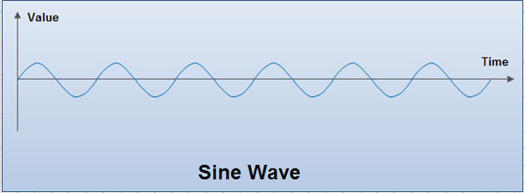
Advantages of Analog Signals
Best suited for the transmission of audio and video.
Consumes less bandwidth than digital signals to carry the same Information.
Analog systems are readily in place around the world.
Analog signal is less susceptible to noise.
6/16/2019
Notes:
Digital signal is more immune to noise. Why?

Slide 11
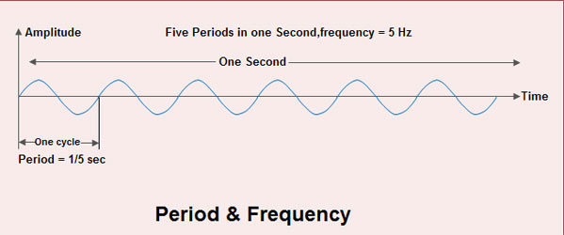
Characteristics of Analog Signal
Amplitude
Amplitude of a signal refers to the height of the signal.
It is equal to the vertical distance from a given point on the waveform to the horizontal axis.
The maximum amplitude of a sine wave is equal to the highest value it reaches on the vertical axis as shown in figure.
Amplitude is measured in volts, amperes or watts depending on the type of signal. A volt is used for voltage, ampere for current and watts for power.
6/16/2019
Notes:
Frequency=6Hz!

Slide 12
Period
Period refers to the amount of time in which a signal completes one cycle.
It is measured in seconds.
Other units used to measure period are millisecond (10-³ sec.) microsecond (1 0-⁶ sec), nanosecond (10-⁹ sec) and picoseconds (10-¹² sec).
Frequency
It refers to the number of wave patterns completed in a given period of time.
To be more precise, frequency refers to number of periods in one second or number of cycles per second.
Frequency is measured in Hertz (Hz)
Other units used to express frequency are kilohertz (10³ Hz) Megahertz (10⁶ Hz), gigahertz (10⁹Hz) and terahertz (10¹² Hz).
Frequency and period are the inverse of each other. Period is the inverse of frequency and frequency is the inverse of period.
6/16/2019

Slide 13
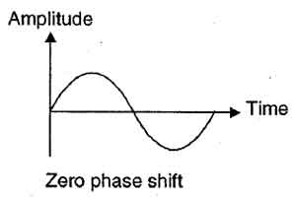
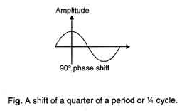
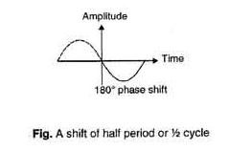
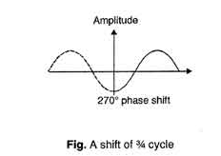
Phase
Phase describes the position of the waveform relative to time zero.
Phase describes the amount by which the waveform shifts forward or backward along the time axis.
It indicates the status of first cycle.
Phase is measured in degrees or radians.
A phase shift of 360 degree indicates a shift of a complete period, a phase shift of 180° indicates a shift of half period and a phase shift of 90° indicates a shift of a quarter of a period as shown in fig. below.
6/16/2019

Slide 14
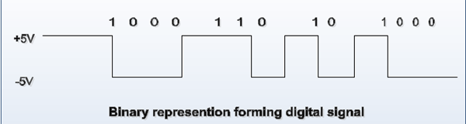
Digital Data Transmission
It can have only a limited number of defined values such as 1 and O.
The transition of a digital signal from one value to other value is instantaneous.
Digital signals are represented by square wave.
In a typical digital signal, 1 is represented by having a positive voltage and 0 is represented by having no voltage or zero voltage as shown in figure.
All the signals generated by computers and other digital devices are digital in nature.
6/16/2019

Slide 15
Characteristics of Digital Signals
Bit interval
It is the time required to send one single bit
Bit rate
It refers to the number of bit intervals in one second.
Therefore bit rate is the number of bits sent in one second as shown in fig.
Bit rate is expressed in bits per second (bps).
Other units used to express bit rate are Kbps, Mbps and Gbps.
1 kilobit per second (Kbps) = 1,000 bits per second
1 Megabit per second (Mbps) = 1,000,000 bits per second
1 Gigabit per second (Gbps) = 1,000,000,000 bits per second
6/16/2019

Slide 16
Advantages of Digital Data Transmission
Digital Data - Digital transmission certainly has the advantage where binary computer data is being transmitted. The equipment required to convert digital data to analog format and transmitting the digital bit streams over an analog network can be expensive, susceptible to failure, and can create errors in the information.
Compression - Digital data can be compressed relatively easily, thereby increasing the efficiency of transmission. As a result, substantial volumes of voice, data, video and image information can be transmitted using relatively little raw bandwidth.
Security - Digital systems offer better security. While analog systems offer some measure of security through the scrambling of several frequencies. Scrambling is fairly simple to defeat. Digital information, on the other hand, can be encrypted to create the appearance of a single, pseudorandom bit stream. Thereby, the true meaning of individual bits, sets of bits, or the total bit stream cannot be determined without having the key to unlock the encryption algorithm employed.
6/16/2019

Slide 17
Quality - Digital transmission offers improved error performance (quality) as compared to analog. This is due to the devices that boost the signal at periodic intervals in the transmission system in order to overcome the effects of attenuation. Additionally, digital networks deal more effectively with noise, which always is present in transmission networks.
Cost - The cost of the computer components required in digital conversion and transmission has dropped considerably, while the ruggedness and reliability of those components has increased over the years.
Upgradeability - Since digital networks are comprised of computer (digital) components, they are relatively easy to upgrade. Such upgrading can increase bandwidth, reduces the incidence of error and enhance functional value. Some upgrading can be effected remotely over a network, eliminating the need to dispatch expensive technicians for that purpose.
Management - Generally speaking, digital networks can be managed much more easily and effectively due to the fact that such networks consist of computerized components. Such components can sense their own level of performance, isolate and diagnose failures, initiate alarms, respond to queries, and respond to commands to correct any failure. Further, the cost of these components continues to drop.
6/16/2019

Slide 18
Data Communication Terminology
There are several common terminologies used in data communication literature:
Channel: The word channel refers to the portion of a link that carries a transmission between a given pair of lines. One link can have many (n) channels.
Data Rate: The data rate defines the number data elements (bits) sent in 1 second. The unit is bits per second (bps).
Signal Rate: The signal rate is the numbers of signal elements sent in 1 second. The unit is baud.
The data rate is sometimes called the bit rate: the signal rate is sometimes called the pulse rate, the modulation rate, or the baud rate.
One goal in data communications is to increase the data rate while decreasing the signal rate. Increasing the data rate increases the speed of transmission; deceasing the signal rate decreasing the bandwidth requirement.
Bandwidth: Bandwidth can be used in two different contexts with two different measuring values:-
Bandwidth in Hertz: Bandwidth in hertz is the range of frequencies contained in a composite signal or the range of frequencies a channel can pass.
Bandwidth in Bits per Second: The term bandwidth can also be referred as the number of bits per second that a channel, a link, or even a network can transmit.
6/16/2019

Slide 19
Standards Organizations
ANSI- American Nationals Standard
Founded in 1918 October 19
Is non Profit Organization
the development of voluntary consensus standards for products, services, processes, systems, and personnel in the United States
IEEE- The Institute of Electrical and Electronics Engineer
IEEE is the world’s largest technical professional organization dedicated to advancing technology for the benefit of humanity.
ISO- The international organization for standards
The International Organization for Standardization is an international standard-setting body composed of representatives from various national standards organizations.
ITU-T – International Telecommunication Union- Telecommunication Standards Sector
Defining the standard of telecommunication but there was still little international compatibility.
The UN responded by forming as apart of ITU
EIA- Electronic Industries Association
6/16/2019

Slide 20
Applications of Data Communications
Airline reservation system
American airline: Sabre system
United airline: Apollo reservation system
Automatic teller machine
Swift: Society for Worldwide Interbank Financial Telecommunication
Sales order entry
Point of sale
Universal product code
Unstructured data application
Electronic mail
Ownership of content
Simple mail transfer protocol (SMTP)
No foreign characters
No executable files
Limited size
Multipurpose Internet mail extensions (MIME)
6/16/2019

Slide 21
Image application
Facsimile (FAX)
Simple for printed documentation
Television
Purpose
Security
Information
Conference
Types
Freeze-frame & full-motion
One-way & two-way
6/16/2019

